Slide 1
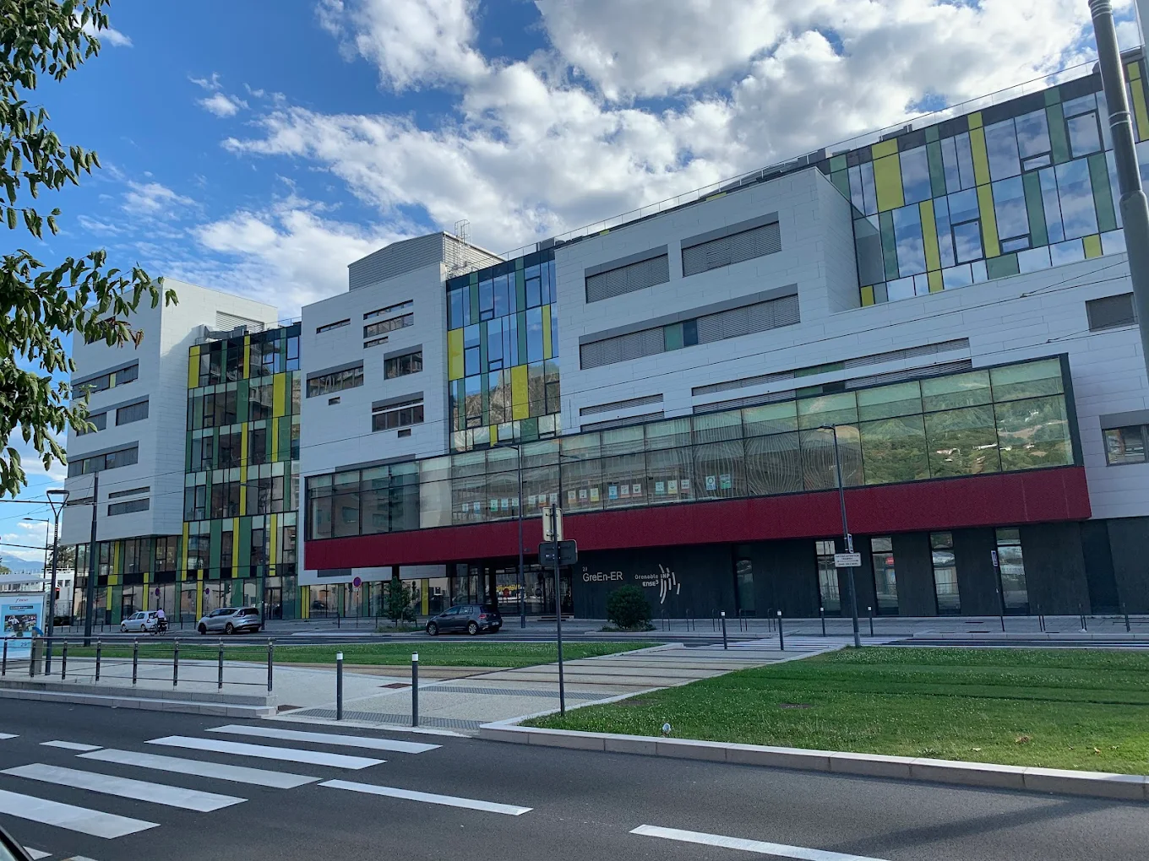

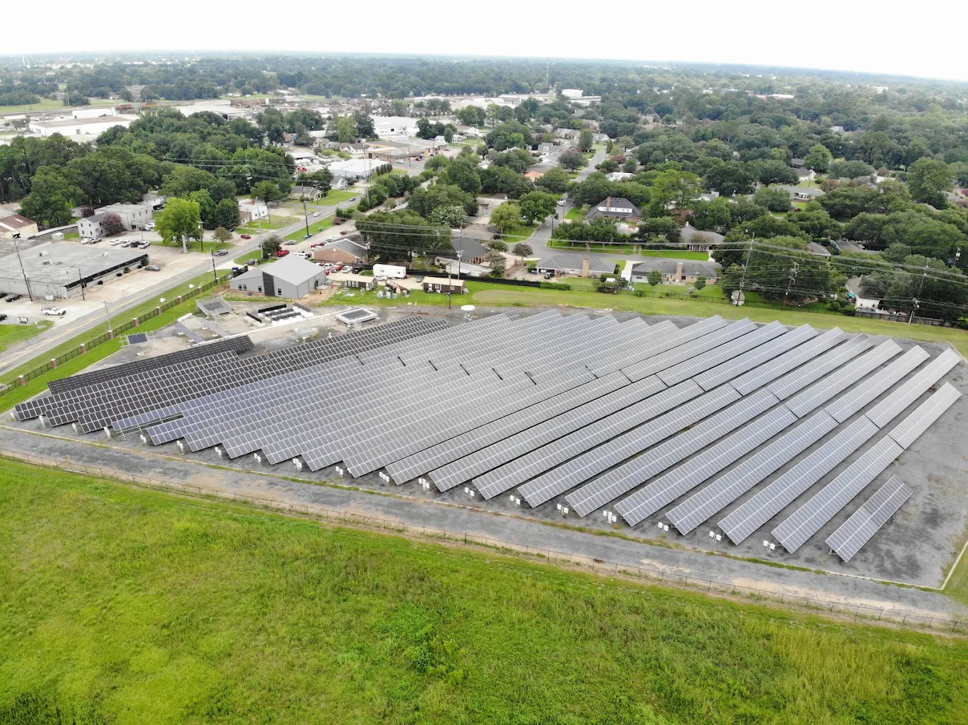
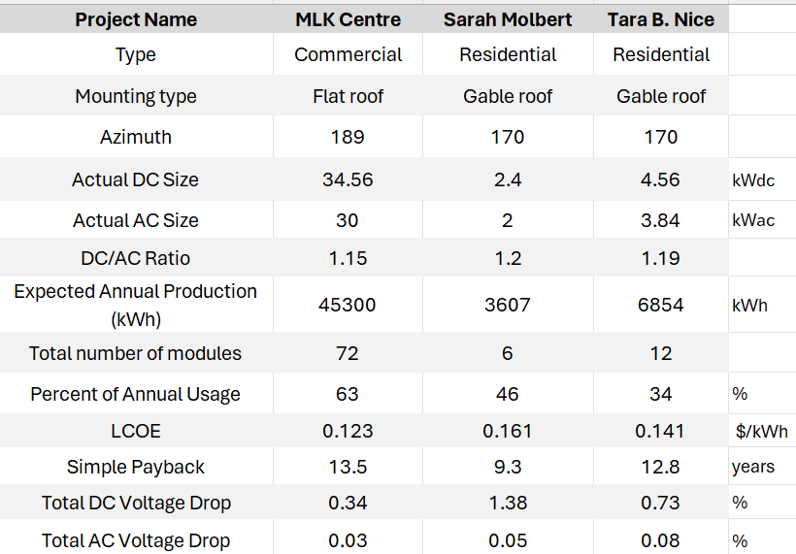
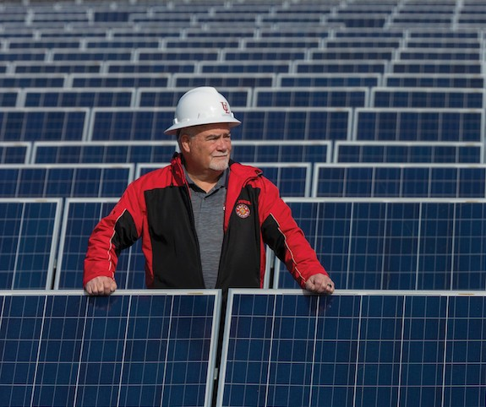
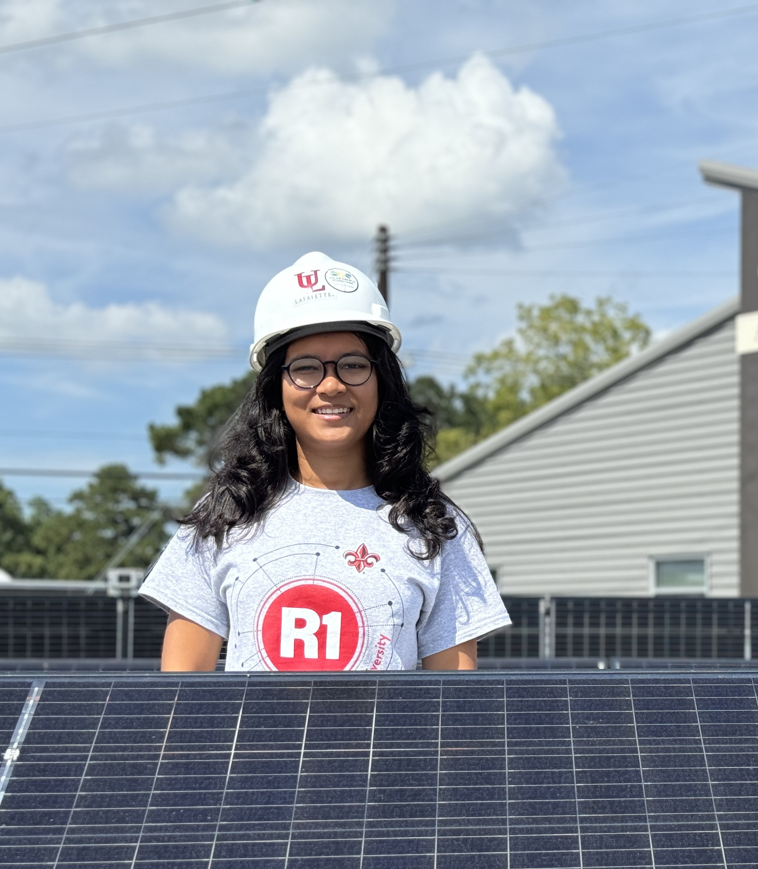
An Analytical Study on the Design of Solar Power Plants for
Residential and Commercial Sector:
Practical Implementation and Cost Analysis
Master Thesis 2024-2025
The Research area
Methodology
Field: Photovoltaic (PV) System Design, Solar Energy Integration, Energy Economics, Code Compliance
Sub-area: Residential & Commercial Solar PV Deployment
Site Survey: Assessed roof, shading, utility data, and environmental factors using PVWatts, ASHRAE, and site tools.
Preliminary System Sizing: Estimated DC size, module count, and energy output based on space and customer usage.
String Sizing: Configured modules using voltage limits, inverter specs, and temperature corrections.
Actual System Size: Validated system specs (DC/AC), energy yield, and financials (LCOE, payback).
Electrical Integration: Sized conductors, protection, and interconnection per NEC 690/705 and voltage drop rules.
Mechanical Integration: Calculated roof loads, spacing, and attachment points per ASCE 7 and IBC.
Problem Statement
Model Development: Accurate system modeling requires site-specific data to ensure realistic sizing and performance.
Practical Implementation: Real-world constraints like shading, roof limits, and permitting often disrupt ideal designs.
Design Complexity: PV systems must meet strict electrical and mechanical codes under varied environmental conditions.
Economic Viability: Changing incentives and utility policies make financial returns uncertain, especially for small systems.
Result
Supervised by
Terrence L. Chambers, Ph.D., P.E.
Donald & Janice Mosing BORSF Endowed Chair in Mechanical Engineering; Director, EDA Green Hydrogen Center of Excellence
University of Louisiana at Lafayette
Objectives
Model PV systems using site-specific data (irradiance, shading, load)
Design layouts that meet NEC/ASCE standards under real-world constraints
Assess system economics via LCOE, payback, and energy offset
Presented by
ROY Jui
Master in Electrical Engineering
for smart grids and buildings

